Slide 1
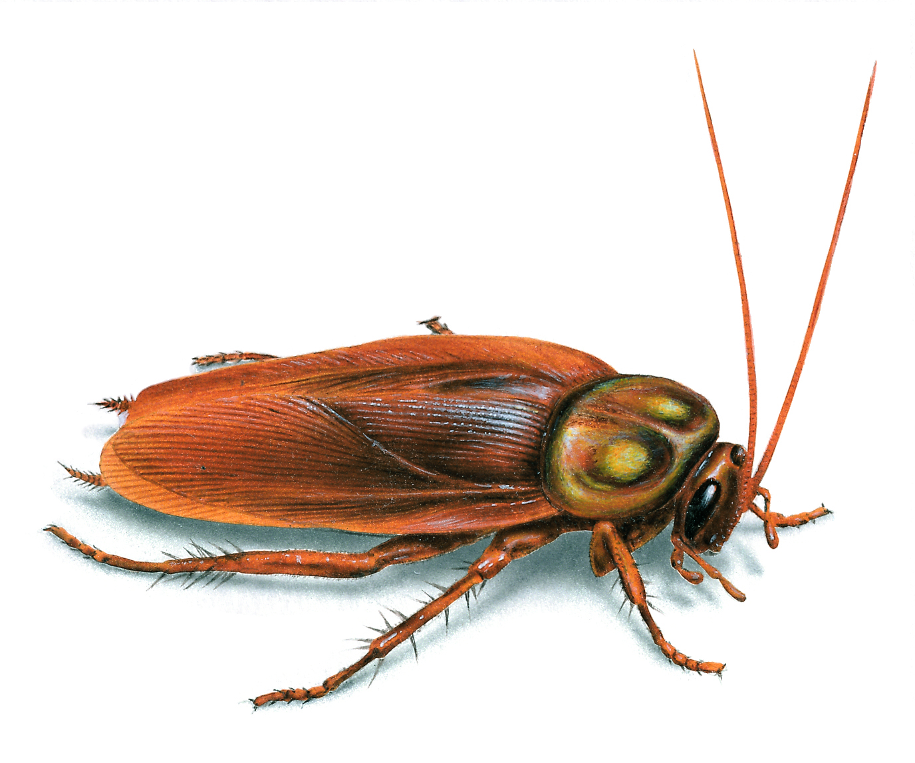
Cockroach Analysis
A Statistical Analysis of the Flash and Java Files that Infest the Internet

Slide 2
Who’s this… guy
10+ years on the defensive side
File analysis, RE, network forensics, some IR
Started to do data analysis and machine learning on security data about 2 years ago

Slide 3
Why Do We Care About This
Take the large amount of data you have and turn it into information you can act on
Gives starting place for hunting and finding new, interesting and unknown malicious files.
Doesn’t rely on easy to avoid signatures
Heuristics on nontrivial boundaries in high dimensional space

Slide 4
Agenda
Tools Used
Vocabulary
Java Analysis
SWF Analysis
Wrap Up
Notes:
For both Java and SWF, I’ll take you through the iterative process of exploring data, extracting features, and testing our feature set

Slide 5
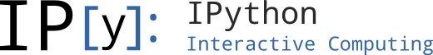
IPython
Interactive Shell
Browser based
Great way to collect
Easy to share results with others
Notes:
Great way to allow others to see your methodology

Slide 6
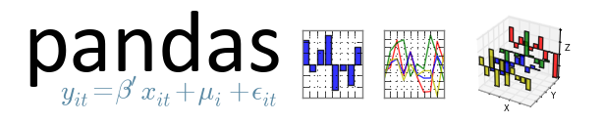
pandas
Provides dataframe functionality to Python
Dataframe is like a spreadsheet
Abstracts out a lot of headaches
Provides a more friendly interface to data
Notes:
Data frame capabilities like in R. It’s kinda an awesome version of an array of dictionaries

Slide 7
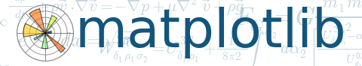
matplotlib
2D plotting library
Tries to make easy things easy and hard things possible
Generate plots, histograms, bar charts, scatterplots and more

Slide 8

scikit-learn
Machine learning in Python
Simple and efficient tools for data mining and data analysis
Does not support Pandas dataframes
Really easy to transform from a dataframe to a supported data type

Slide 9
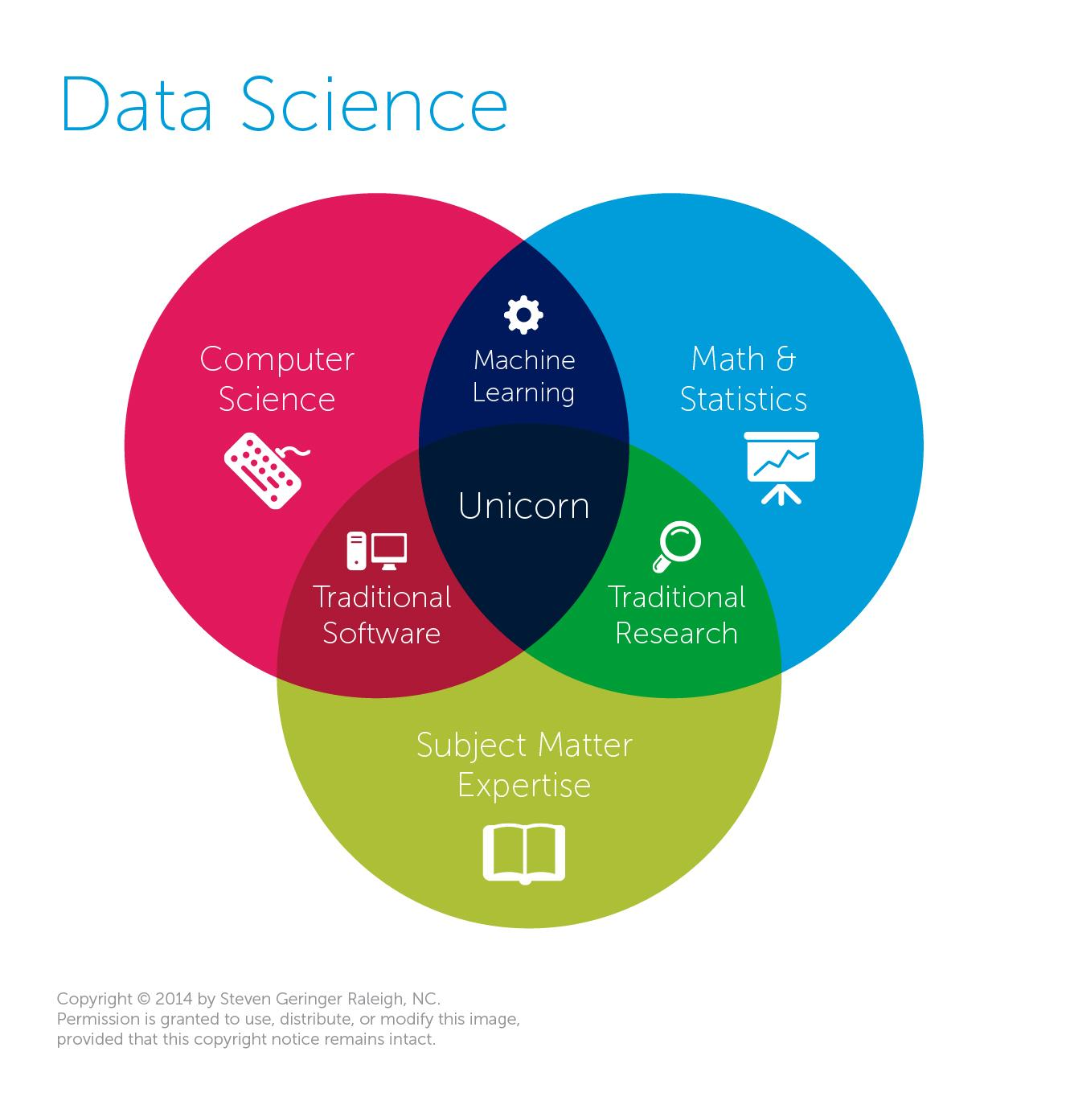
Notes:
Data Science is about asking your data questions, and ideally getting actionable information back from it.
To do data science, you’ll someone with subject matter expertise to know what to look for, an expert in statistical analysis, and someone to write the code to do all of this.
Fortunately for me, scikit-learn takes care of mosting of the coding and the math.

Slide 10
Ground Truth
Accuracy in labels
Ideally, 100% accuracy in your labels

Slide 11
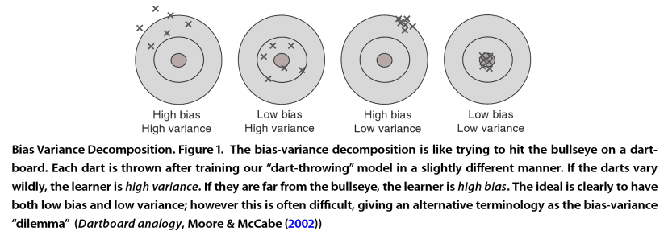
Bias And Variance
Notes:
The bias is error from erroneous assumptions in the learning algorithm. High bias can cause an algorithm to miss the relevant relations between features and target outputs (underfitting).
The variance is error from sensitivity to small fluctuations in the training set. High variance can cause overfitting: modeling the random noise in the training data, rather than the intended outputs.
Usually there is a trade off between bias and variance.

Slide 12
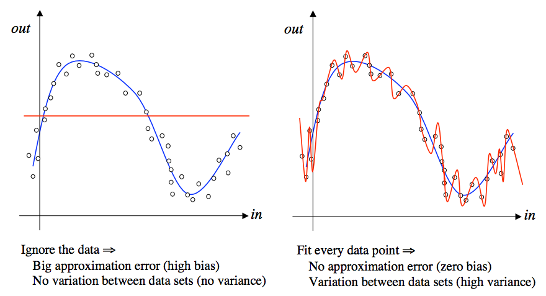
(Over|Under)fitting
http://www.cs.bham.ac.uk/~jxb/INC/l9.pdf

Slide 13
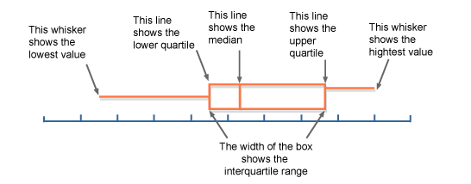
Boxplot
Notes:
Box plot is a standardized way of displaying the distribution of data based.
Middle line is the median
The box contains the middle 50% of the data

Slide 14
Cross Validation
Validation technique for assessing how the results of a statistical analysis will generalize to an independent data set
Randomly partition the data
Train model on one set, test on the other set
Repeat k times
Notes:
In our notebooks, when we calculate the cross validation score, we randomly select 80% of the data to train on, and test on the other 20%. We do this 10 times to ensure that we didn’t just get a “lucky” training set.

Slide 15

Decision Trees
Maps observations about an element to labels
Leaves are labels and branches are observations that lead to labels
Notes:
A decision tree is a flowchart-like structure in which each internal node represents a "test" on an attribute (example here is about determining if a person survived the Titanic), each branch represents the outcome of the test and each leaf node represents a class label (decision taken after computing all attributes). The paths from root to leaf represents classification rules.

Slide 16
Random Forest
Forest (group) of randomly created decision trees
Random feature selection for trees used to control variance
Not prone to overfitting
Classification answer is the result that appears most frequently from the decision trees
Notes:
2 labels in this talk, benign and malicious, the threshold for the label is 50%

Slide 17

The Data
300K uncompressed SWF
370K Java class files
Can get IPython notebooks at https://github.com/ClickSecurity/data_hacking

Slide 18
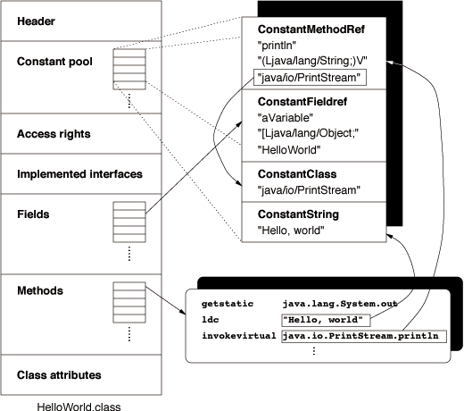
Java Class File Highlights
Version
Class name
Super class name
Constant Pool
Access Flags
Interfaces
Methods
Attributes
Notes:
Constant Pool contains information like strings, method names
Access flags used to denote access permissions and properties of this class or interface
Like if it’s public class, abstract class

Slide 19

Java Class Files
370K Java class files
Probably all benign
2K known malicious files
Start with 500 of each
Notes:
Used VirusTotal to verify they are benign or malicious
500 not really enough to make a real classifier, just an amount to start the exploration on

Slide 20
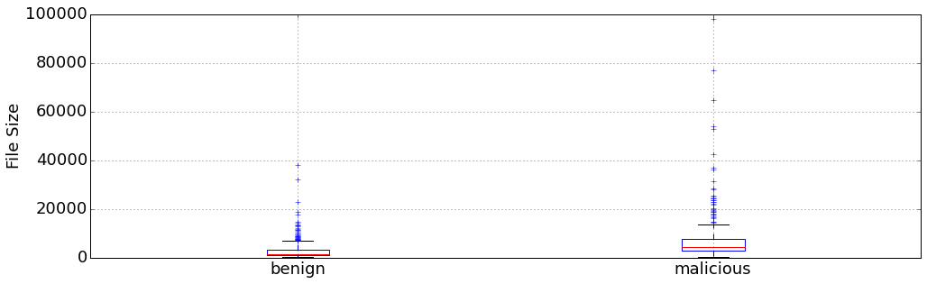
File Size Comparison

Slide 21
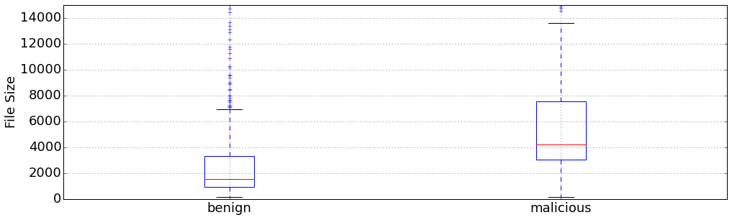
File Size Comparison (zoomed in)

Slide 22
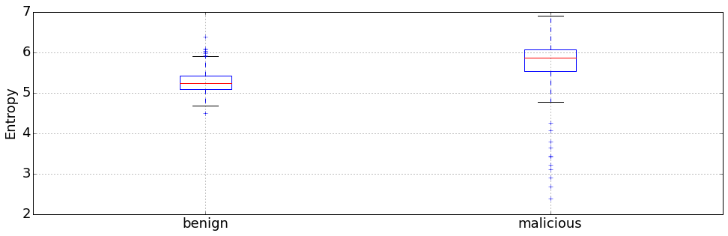
Entropy Comparison
Notes:
Entropy on whole file

Slide 23
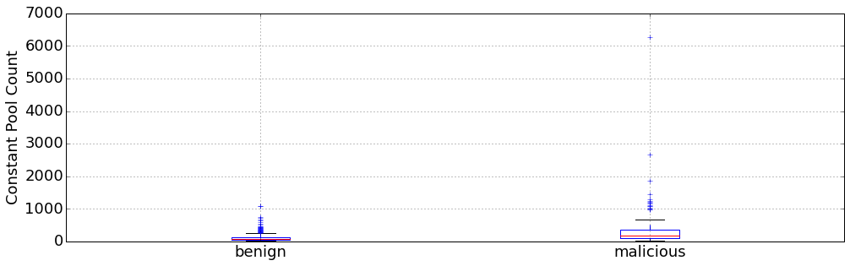
Constant Pool Count Comparison
Notes:
This is the number of elements in the constant pool

Slide 24
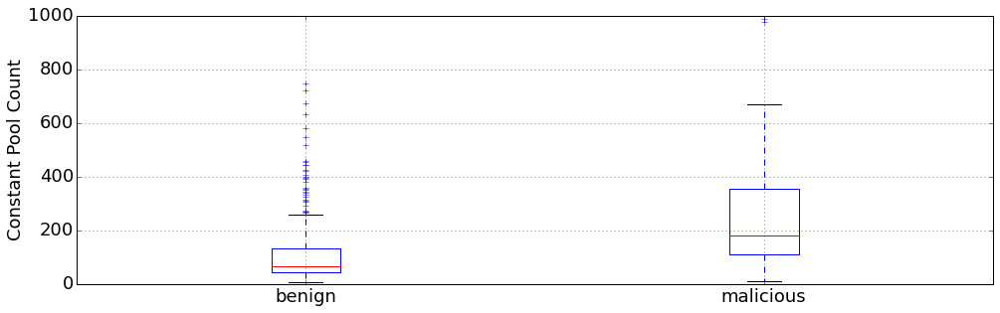
Constant Pool Count Comparison (zoomed in)

Slide 25
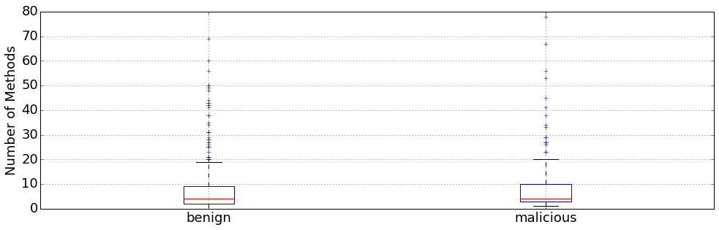
Number of Methods Comparison
Notes:
A lot of overlap… maybe really low numbers more often associated with benign, but not a clear demarcation.

Slide 26
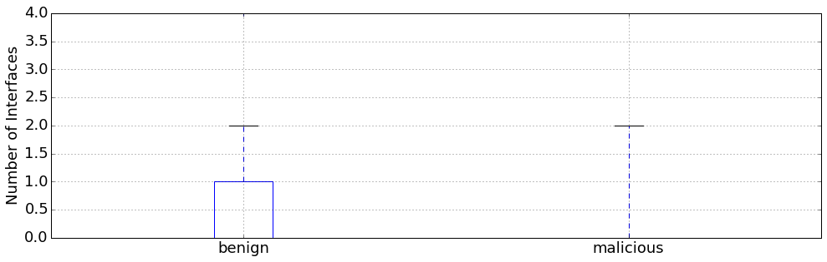
Number of Interfaces Comparison
Notes:
Well, they can’t all be winners

Slide 27
First Pass Classifier Feature Set
Each flag from access rights
Number of access flags set
Major & minor version
Entropy
Size
Constant pool size
Number of methods
Number of interfaces
Notes:
Very easy set to retrieve, not a lot of feature creation done here

Slide 28
Cross Validation Results
10 fold
Accuracy: 92.7% +/- 4.6

Slide 29
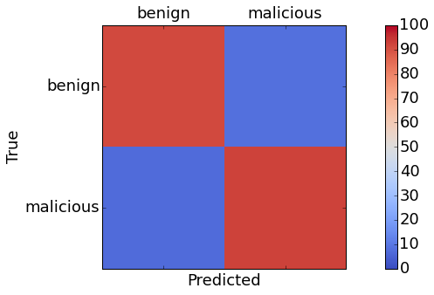
Confusion Matrix
benign/benign: 91.67% (88/96)
benign/malicious: 8.33% (8/96)
malicious/benign: 7.41% (8/108)
malicious/malicious: 92.59% (100/108)
Notes:
Talk about 80/20

Slide 30
Feature Importance
Entropy
Constant pool size
File size
Number of methods
Number of interfaces
Major version
acc_public
Number of access flags
0.30666
0.22264
0.15842
0.08960
0.05482
0.05328
0.03754
0.03316
Notes:
The feature importance is determined by scikit learns RF algorithm. Before hand, I have no idea exactly how important certain features are. So we let the algorithm tell us what is important.
Remember the box plots

Slide 31
Need More Features
Method names and attributes
Class name
Super class name

Slide 32
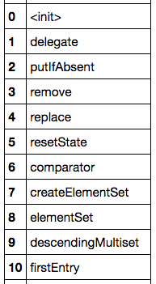
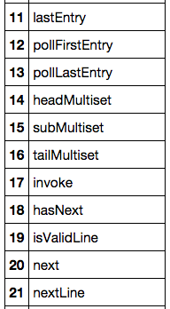
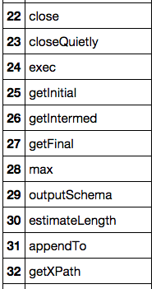
Benign Method Names
Notes:
Looks normal

Slide 33
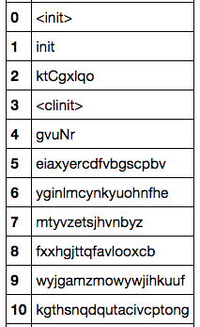
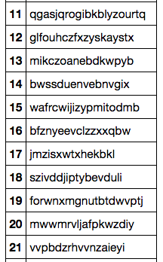
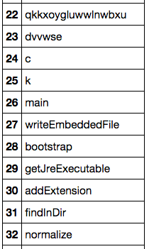
Malicious Method Names
Notes:
Some look ok, some look like my 2 year old son typed them

Slide 34
Feature Creation
Took inspiration from spam filter
http://thinktostart.com/build-a-spam-filter-with-r/
Max length of consecutive digits, lower case, and upper case letters
Average length of consecutive digits, lower case, and upper case letters

Slide 35
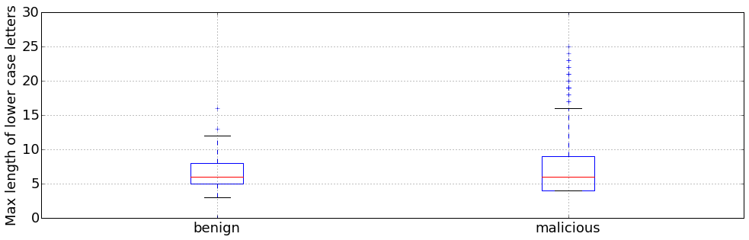
Max Length of Consecutive Lower Case Letters

Slide 36
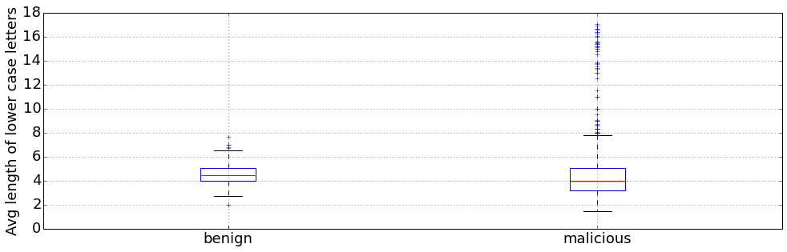
Average Length of Consecutive Lower Case Letters

Slide 37
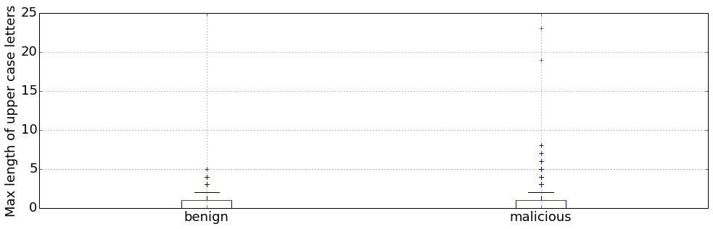
Max Length of Consecutive Upper Case Letters

Slide 38
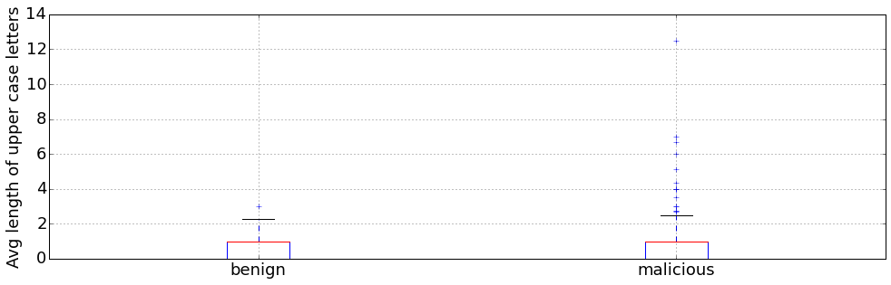
Average Length of Consecutive Upper Case Letters

Slide 39
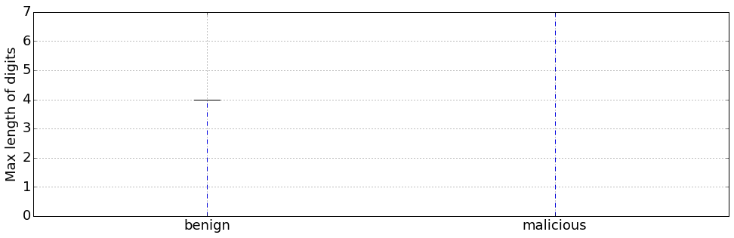
Max Length of Consecutive Digits

Slide 40
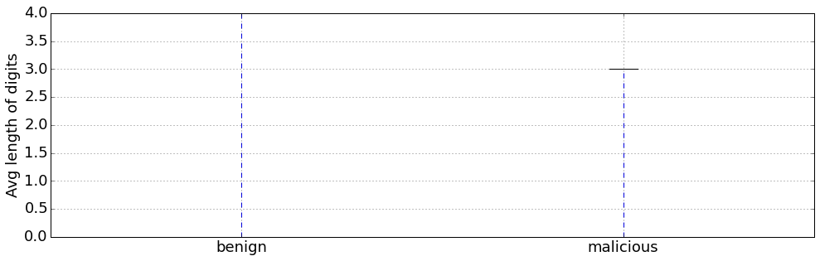
Average Length of Consecutive Digits

Slide 41
Cross Validation Results
10 fold
Accuracy: 94.9% +/- 4.0
Notes:
Still within margin of error, but slight improvement.

Slide 42
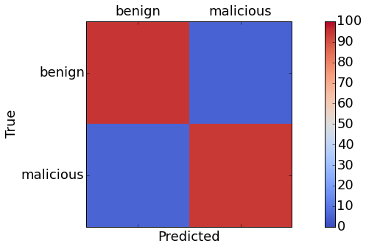
Confusion Matrix
benign/benign: 94.79% (91/96)
benign/malicious: 5.21% (5/96)
malicious/benign: 5.56% (6/108)
malicious/malicious: 94.44% (101/108)
Notes:
Slight improvement on TPs, TNs, FPs, and FNs

Slide 43
Feature Importance
Entropy
Constant pool size
File size
Method name lower case avg
Method name lower case max
Method name upper case avg
Number of interfaces
Number of methods
0.25620
0.13497
0.12721
0.08061
0.05628
0.05525
0.05329
0.05135
Notes:
Entropy, constant pool size, and file size still are the most important, but their weight isn’t as much. Before, they were almost 2/3s of the importance, now there are only half. Method name features are somewhat important.

Slide 44
Still Need More Features
Still have class name
Still have super class name
Method attributes
Class attributes
Interface

Slide 45
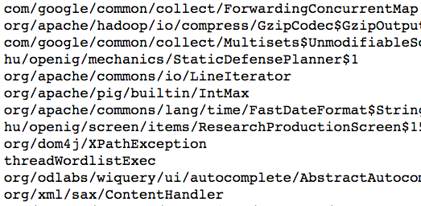
Benign Class Names
Notes:
Normal words, relatively long, looks like several slashes

Slide 46
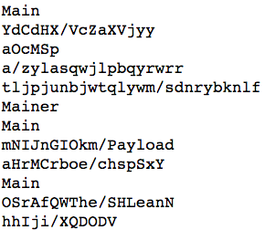
Malicious Class Names

Slide 47
More Feature Creation
Length of class name
Number of slashes in class name
Max length of consecutive digits, lower case, and upper case letters
Average length of consecutive digits, lower case, and upper case letters

Slide 48
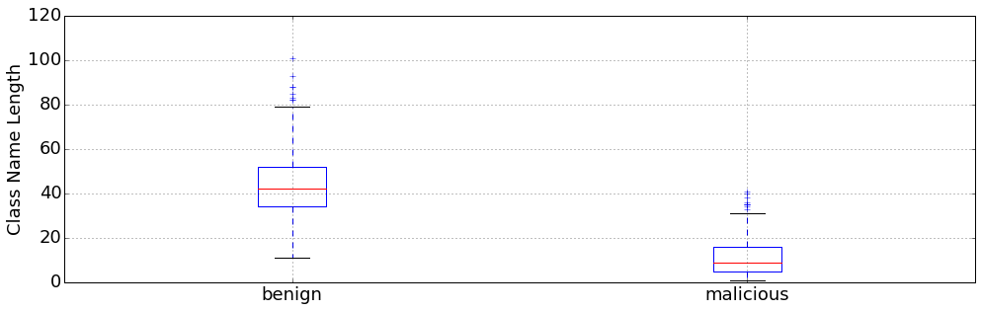
Class Name Length

Slide 49
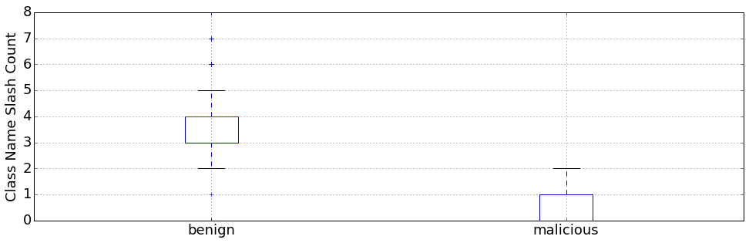
Class Name Slash Count

Slide 50
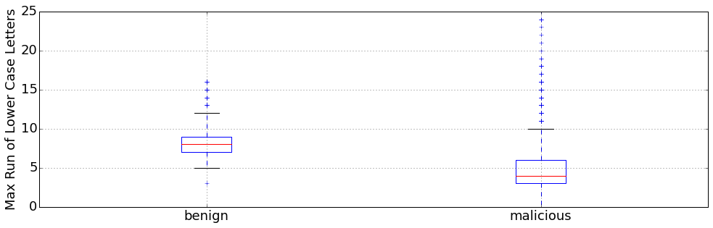
Longest Run of Consecutive Lowercase Letters

Slide 51
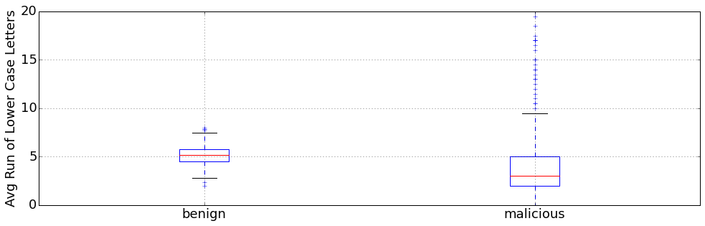
Average Run of Consecutive Lowercase Letters

Slide 52

Cross Validation Results
10 fold
Accuracy: 99.4% +/- 1.3

Slide 53
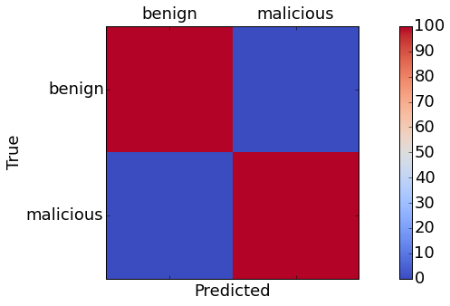
Confusion Matrix
benign/benign: 100.00% (92/92)
benign/malicious: 0.00% (0/92)
malicious/benign: 0.0% (0/112)
malicious/malicious: 100.00% (0/112)

Slide 54
Knobs To Turn
Random Forest allows you to modify the threshold for classification
The default threshold in 2 label case is 50%
We can increase the threshold to decrease FP rate
We can decrease the threshold to increase TP rate
Notes:
Decreasing FP rate comes at the prices for a lower detection rate
Increasing detection rate comes at the price of increased FPs

Slide 55
80% Confusion Matrix
benign/benign: 100.00% (92/92)
benign/malicious: 0.00% (0/92)
malicious/benign: 2.68% (3/112)
malicious/malicious: 97.32% (109/112)

Slide 56
20% Confusion Matrix
benign/benign: 98.91% (91/92)
benign/malicious: 1.09% (1/92)
malicious/benign: 0.00% (0/112)
malicious/malicious: 100.00% (112/112)

Slide 57
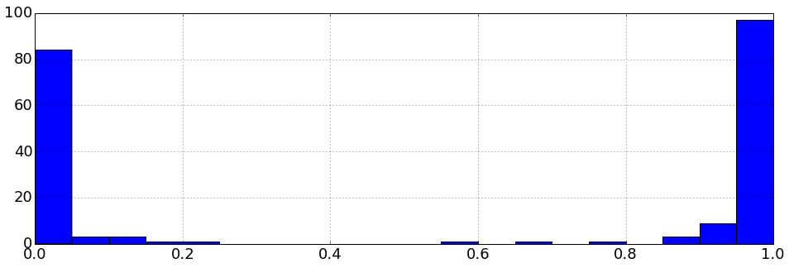
Score Distribution

Slide 58
Feature Importance
Class Name Slash Count
Class Name Length
Class Name Lower Case Max
Entropy
Class Name Lower Case Avg
Constant Pool Count
Class Name Upper Case Max
Size
0.30258
0.27841
0.07751
0.06485
0.05893
0.04767
0.03479
0.02790
Notes:
Now the classifier is dominated by features from the class name.

Slide 59
Classifier Results
How does the classifier work on the 366K files?
340K files marked as benign (score < 0.5)
11K files in gray area (0.5 <= score < 0.8)
15K files marked as malicious (0.8 <= score)
Notes:
That doesn’t seem good

Slide 60
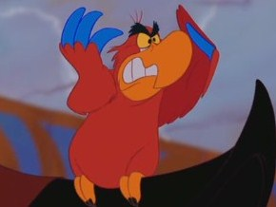
#iago
Not really a surprise
500 files of each is really not enough
Let’s use more data!

Slide 61
A New Classifier
2000 labeled malicious files
Label 2000 randomly chosen files as benign
Cross Validation Score: 99.0% +/- 1.1
Notes:
Still within margin of error, but slight improvement.

Slide 62
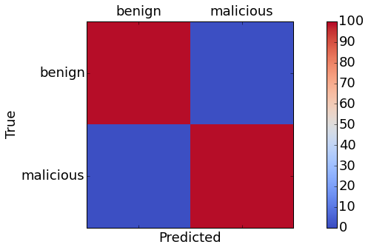
Confusion Matrix
benign/benign: 99.01% (400/404)
benign/malicious: 0.99% (4/404)
malicious/benign: 1.05% (4/380)
malicious/malicious: 98.95% (376/380)
Notes:
Explain the 80/20 split again

Slide 63
Classifier Results - Part 1
How does the classifier work on the 364K files?
299K files marked as benign (score < 0.5)
64K files in gray area (0.5 <= score < 0.8)
840 files marked as malicious (0.8 <= score)
Notes:
Huge increase in gray, big decrease in malicious

Slide 64
Classifier Results - Part 2
Train another classifier using a different random 2000 benign files
360K files marked as benign (score < 0.5)
3.3K files in gray area (0.5 <= score < 0.8)
1.3K files marked as malicious (0.8 <= score)
Notes:
Much more manageable gray and malicious amounts. Though probably still needs work.

Slide 65
Classifier Results - Part 3
Train yet another classifier using a different random 2000 benign files
359K files marked as benign (score < 0.5)
3.7K files in gray area (0.5 <= score < 0.8)
1.3K files marked as malicious (0.8 <= score)
Notes:
10 fold

Slide 66
Java Summary
Can detect malicious files using data science
Variability in results on large pile of files depending on test data
A classifier that seems good at classifying class names
More data seems to give better results

Slide 67
Next Steps
More malicious files
Better labeled data
Not just good/bad
Exploit Kit
CVE
New features
Better features from method and class names
More features about methods
N-Gram analysis on actual Java bytecode

Slide 68

Adobe Flash
288K Uncompressed SWF
Probably all benign
628 known malicious files
Start with 500 benign and all the malicious
Notes:
Used VirusTotal to verify they are benign or malicious
500 not really enough to make a real classifier, just an amount to start the exploration on

Slide 69
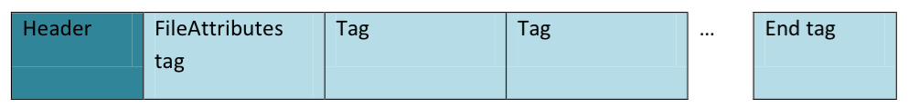
SWF File Highlights
Version
Frame Count
Frame Rate
Frame Size
Number Of Tags
Tag Information
Notes:
Constant Pool contains information like strings, method names, …

Slide 70
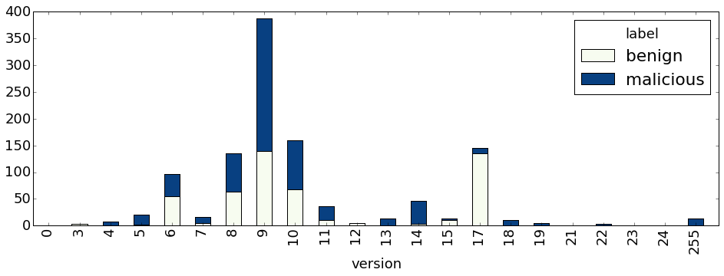
Versions Seen
Notes:
Version 9 was with ActionScript3 was introduced.

Slide 71
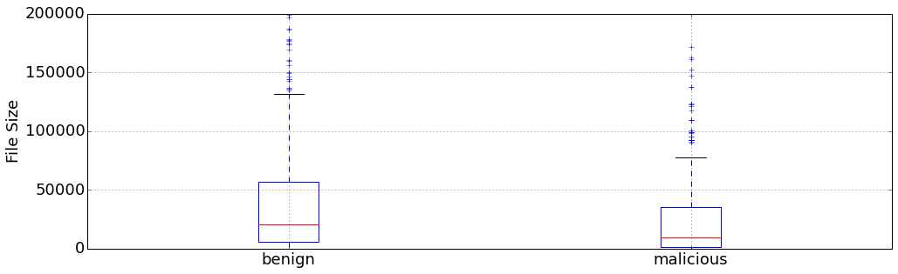
File Size Comparison

Slide 72
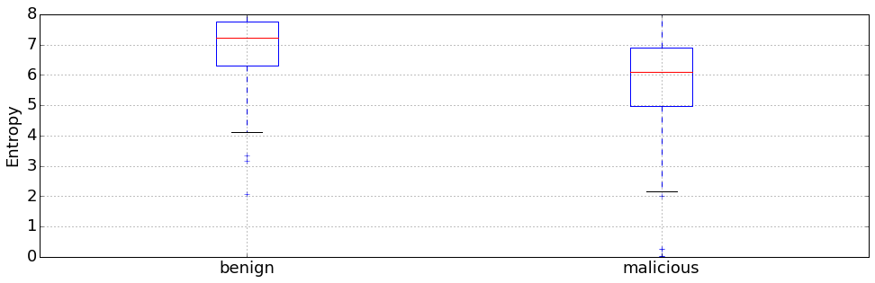
Entropy Comparison

Slide 73
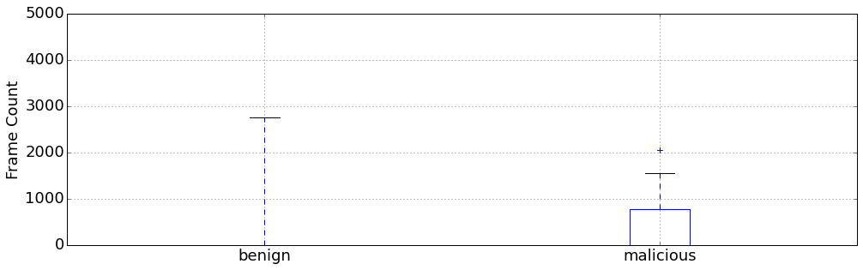
Frame Count Comparison
Notes:
The vast majority of benign swfs (390) had a frame count of 1

Slide 74
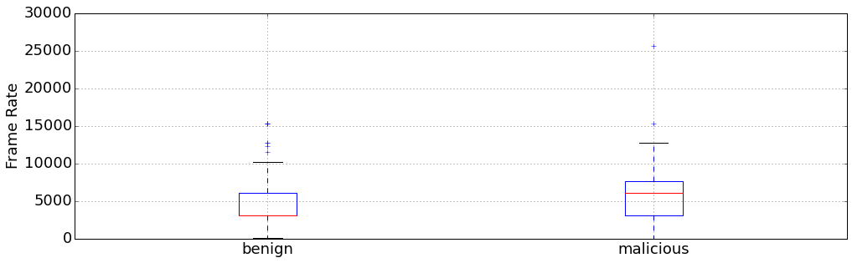
Frame Rate Comparison

Slide 75
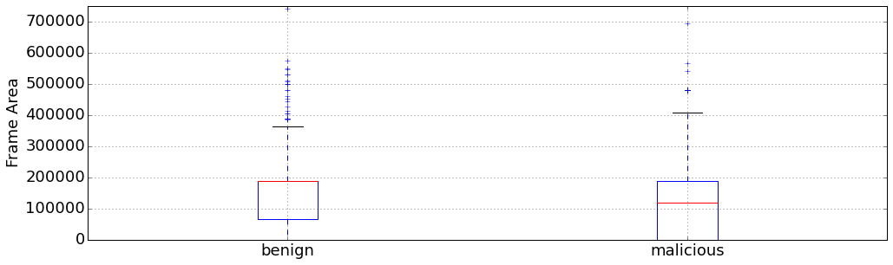
Frame Area Comparison

Slide 76
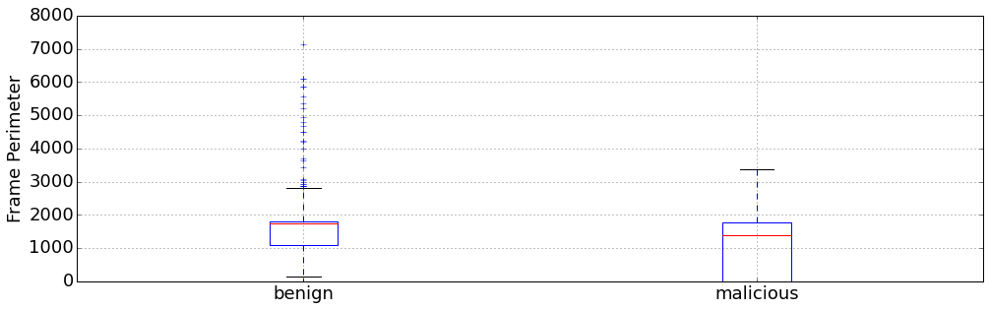
Frame Perimeter Comparison

Slide 77
Cross Validation Results
10 fold
Accuracy: 96.1% +/- 3.2
Notes:
This is surprisingly good. Probably artificially good.

Slide 78
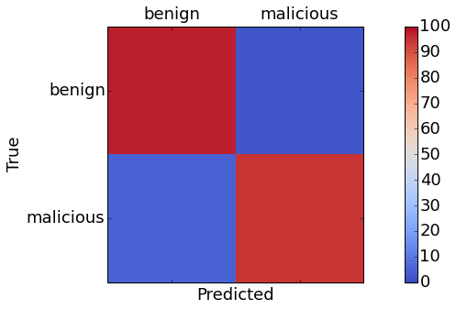
Confusion Matrix
benign/benign: 97.37% (111/114)
benign/malicious: 2.63% (3/114)
malicious/benign: 5.45% (6/110)
malicious/malicious: 94.55% (104/110)

Slide 79
Feature Importance
Entropy
Frame Area
Frame Perimeter
Size
Version
Frame Rate
Frame Count
0.24429
0.17804
0.15848
0.12977
0.12801
0.11892
0.04248

Slide 80
Tag Information
A tag can exist multiple times
Only take into consideration the existence of a tag in the file, not the number of them
An End tag should be the last tag
Notes:
This is surprisingly good. Probably artificially good.

Slide 81
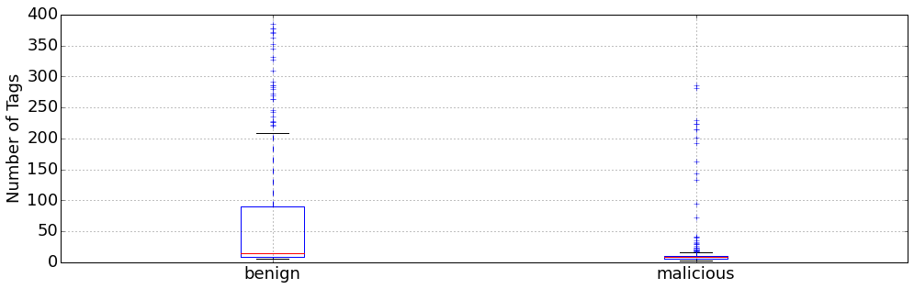
Number Of Tags Comparison

Slide 82

PlaceObject2 Comparison

Slide 83

DoABC Comparison

Slide 84

DoABCDefine Comparison

Slide 85

DefineBitsJPEG2 Comparison

Slide 86

End Comparison

Slide 87
Cross Validation Results
10 fold
Accuracy: 96.8% +/- 2.7
Notes:
No real difference

Slide 88

Confusion Matrix
benign/benign: 97.75% (87/89)
benign/malicious: 2.25% (2/89)
malicious/benign: 1.48% (2/135)
malicious/malicious: 98.52% (133/135)
Notes:
Slight improvement on TPs, TNs, FPs, and FNs

Slide 89
Feature Importance
Entropy
Number Of Tags
Frame Rate
Version
Frame Area
Frame Perimeter
PlaceObject2
Size
DefineShape3
0.10226
0.09275
0.07430
0.07110
0.06588
0.06246
0.05839
0.05102
0.03744

Slide 90
ActionScript
Allows Flash to be interactive
Multiple Versions
Structured similarly to Java Class files
The bane of my existence
Notes:
In the sense that there is a constant pool, a section for methods

Slide 91

ActionScript String Count Comparison
Notes:
The benign values are anchored by zeroes for all the files that do not include actionscript at all

Slide 92

Mean to Median String Length Ratio
Divide the mean line length by the median line length
Higher ratio is more suspicious

Slide 93

ActionScript Mean/Median Ratio Comparison
Notes:
The benign values are anchored by zeroes for all the files that do not include actionscript at all

Slide 94
Cross Validation Results
10 fold
Accuracy: 97.1% +/- 2.9

Slide 95

Confusion Matrix
benign/benign: 98.10% (103/105)
benign/malicious: 1.90% (2/105)
malicious/benign: 0.84% (1/119)
malicious/malicious: 99.16% (118/119)

Slide 96
Feature Importance
Entropy
PlaceObject2
ActionScript String Count
Size
Number Of Tags
Frame Rate
Frame Perimeter
Version
Frame Area
0.08949
0.07960
0.06956
0.05697
0.05196
0.05035
0.04962
0.04840
0.04566

Slide 97
Classifier Results
How does the classifier work on the 290K files?
279K files marked as benign (score < 0.5)
8K files in gray area (0.5 <= score < 0.8)
2K files marked as malicious (0.8 <= score)
Notes:
Just under 8K and 2K
Not horrible, but of course we’d like better. Small set of files. Let’s try again

Slide 98
A New Classifier
620 labeled malicious files
Label 5000 randomly chosen files as benign
Cross Validation Score: 99.0% +/- 0.4
Notes:
That;s better

Slide 99

Confusion Matrix
benign/benign: 99.90% (992/993)
benign/malicious: 0.10% (1/993)
malicious/benign: 0.76% (1/132)
malicious/malicious: 99.14% (131/132)

Slide 100
Feature Importance
Entropy
Frame Perimeter
Frame Area
ActionScript String Count
Frame Count
ActionScript String Size Ratio
Size
Frame Rate
End Tag
0.08452
0.08293
0.08219
0.06897
0.06435
0.06046
0.05533
0.04375
0.04332

Slide 101
Classifier Results
How does the classifier work on the 284K files?
283K files marked as benign (score < 0.5)
679 files in gray area (0.5 <= score < 0.8)
407 files marked as malicious (0.8 <= score)
Notes:
Not horrible, maybe even manageable

Slide 102
Targeted Classifiers
What happens when we limit the classifier to only train and test on files with ActionScript?
Cross Validation Score: 99.1% +/- 0.7
Notes:
This was actually surprising to me. My assumption before hand was that we’d get better results if we had a classifier with SWFS with actionscript, and another for SWFs that didn’t. I was wrong.

Slide 103
Classifier Results
How does the classifier work on the 153K files with ActionScript?
152K files marked as benign (score < 0.5)
546 files in gray area (0.5 <= score < 0.8)
284 files marked as malicious (0.8 <= score)
Notes:
About half the files, the whole way around. No real improvement.

Slide 104
SWF Summary
Can detect malicious files using data science
Classifier isn’t overly dependent on any one feature
Separating out a specific classifier for SWFs with ActionScript did not increase accuracy
Classifier seems to perform well on the random set of files

Slide 105
Next Steps
More malicious files
Better labeled data
Not just good/bad
Exploit Kit
CVE
New features
More ActionScript features
N-Gram analysis on actual ActionScript code
G-Test Analysis on methods called

Slide 106
Highlights
Using data science to detect new malicious files is useful
Can detect malicious files without signatures
Java classifier is heavily dependent on class name
SWF classifier is not highly dependent on any one field
Training with more data can make the classifier better
Notes:
Useful, assuming there is a way to productize the data or enable it in analysis for normal teams to do for themselves.

Slide 107
Pitfalls
Try to avoid having one really dominant feature
Sometimes features you think are great don’t help that much
Test on a lot of data

Slide 108
Where Do We Go From Here
Need more data
Verify data is labeled appropriately
More sophisticated labels
Extract more features

Slide 109
Play At Home
Notebooks and data are available at https://github.com/ClickSecurity/data_hacking
The data I used from the 300K files can be obtained by contacting me
Notes:
Too large for github

Slide 110

@trogdorsey
trogdorsey at gmail . com
https://github.com/ClickSecurity/data_hacking
http://docs.oracle.com/javase/specs/jvms/se7/html/jvms-4.html
http://wwwimages.adobe.com/www.adobe.com/content/dam/Adobe/en/devnet/swf/pdf/swf-file-format-spec.pdf
http://www.adobe.com/content/dam/Adobe/en/devnet/actionscript/articles/avm2overview.pdf
http://hooked-on-mnemonics.blogspot.com/2013/02/detecting-pdf-js-obfuscation-using.html

